Slide 1
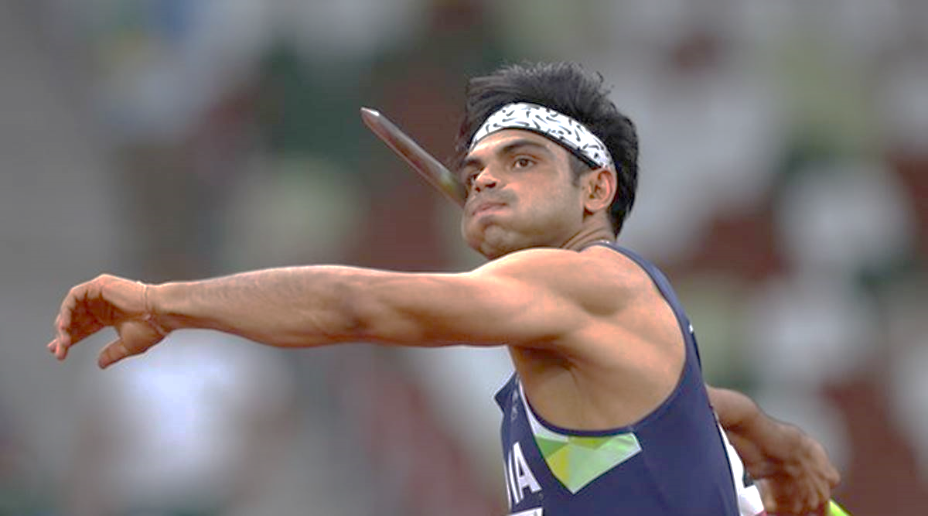
SPORTS AND WELL-BEING
The Psychology of Performance
R. Guha

Slide 2
Need for the course
Considering the current pandemic, WHO highlights the importance of physical and psychological fitness to deal with stressors
Instead of following a regime for fitness blindly, it is thus imperative to comprehend the science of exercise and its relationship with physical and cognitive functions and over all well being
Tokyo 2020 Olympics – shows that Sports could be an alternative career

Slide 3
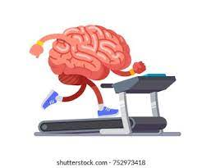
Objectives
Outcomes
Understand the influence of psychological factors on involvement and performance in sport, exercise and physical education settings
Understand how participation in sport, exercise and physical education influences the psychological make-up of those individuals involved
Apply and exercise psychology skills and knowledge to increase individual well-being and interpersonal relationships
To understand how participation in sports affects physical and psychological development
To understand how psychological factors influence physical performance
To understand how psychological factors influence physical performance

Slide 4
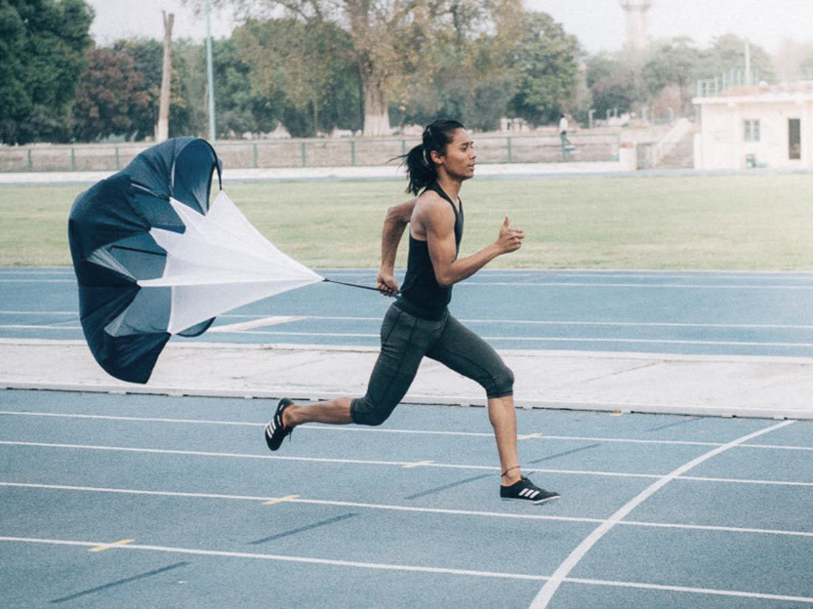
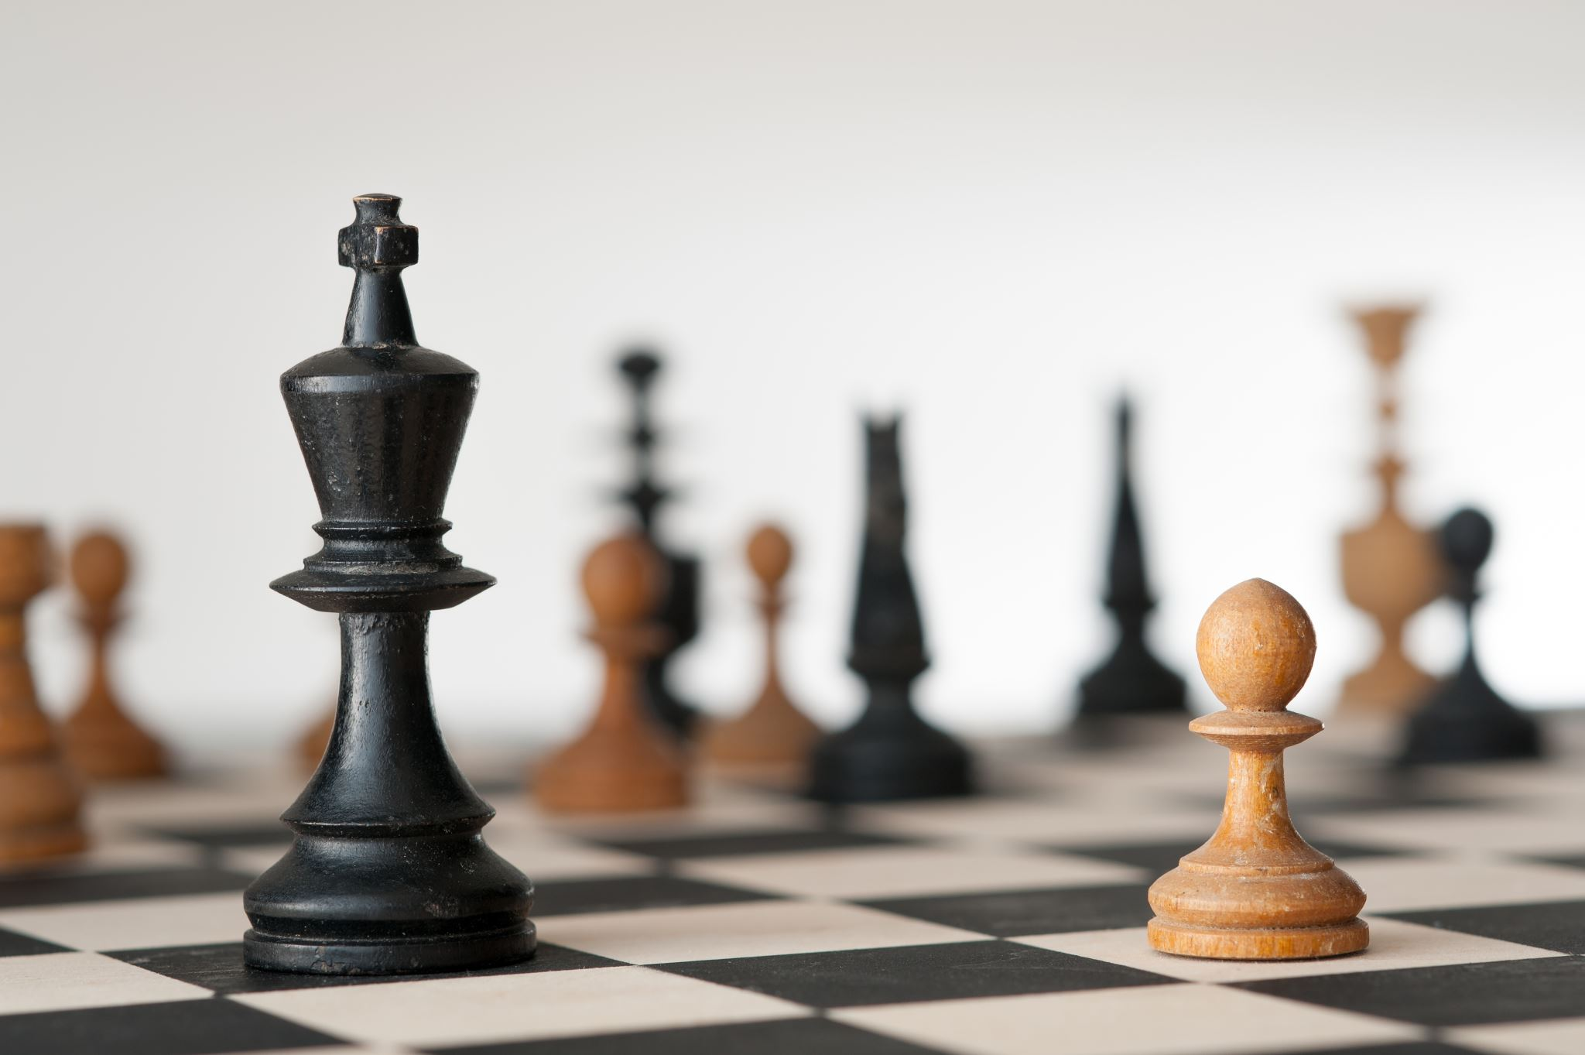
Outdoor Sports – a primary physical endevour
Marshalling of bodily resources to complete a variety of specialized, demanding physical tasks
Physical attributes such as speed, strength, stamina, fitness, coordination, agility, flexibility, and resilience are effect performance
Despite emphasis on physical matters in the sport sciences,
Well accepted that sport performance is influenced not only by physical attributes, but also by psychological factors
Exceptions
Cognitive games
Chess, Sudoku, Go

Slide 5
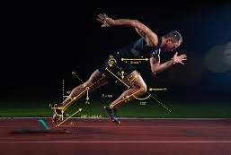
Importance of biomechanics in sports and fitness

Slide 6
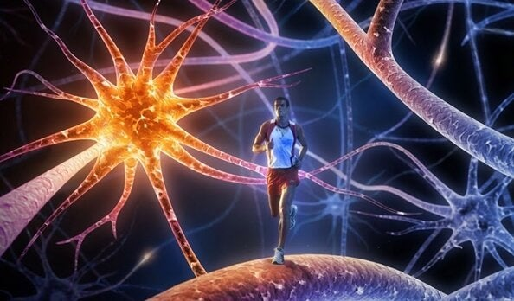
Sports psychology in the game
Sports engagement for enhancement of psychological skills
Dealing with immediate and chronic stress
Performance anxiety
Motivational issues
Dealing with competition
Dealing with failure
Team building
Arousal motivation and activation
Self Confidence
Creativity
Cognitive flexibility
Improves response time in cognitive activities
Attentional focus
Cohesion and team building – cooperation
Leadership skills

Slide 7
Historical underpinnings of Sports Psychology
Sport psychology got its start in about 1891, when the general psychological principles started to be applied in a unique setting: physical education
Luther Gulick offered a seminar for students studying to be physical training directors. It was during this seminar that James Naismith was encouraged to develop a new indoor game, and basketball was invented
In that same year, Naismith gave a commencement address entitled “Psychology of Exercise”
The use of psychological methods to calm the mind, relax the body, or alter mental and physical states of being documented in eastern traditions
The use of such methods for the enhancement of sport performance is, more recent

Slide 8
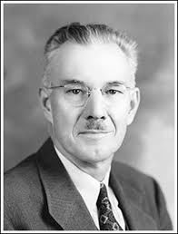
E. W. Scripture (1893-1901) studied reaction times of athletes. Scripture expressed a belief that psychology could have an influence on sport performance
Recognizing the potential for application of psychological principles to sports performance, the Chicago Cubs baseball team hired Coleman Griffith, University of Illinois, as a sport psychologist in the 1920s
Olympics in France in 1897 - “Psychology of Exercise” presented as part of a scholarly meeting to promote the science of athletics
Positive self-talk became the most researched topics in sport psychology, and was addressed in 1913 at the first International Congress of the Psychology and Physiology of Sport
Psychology for performance enhancement soon extended beyond sport, with studies of psychology applied to business in 1917 and the psychology of musical talent in 1919
Historical underpinnings
of Sports Psychology
Coleman Griffith

Slide 9
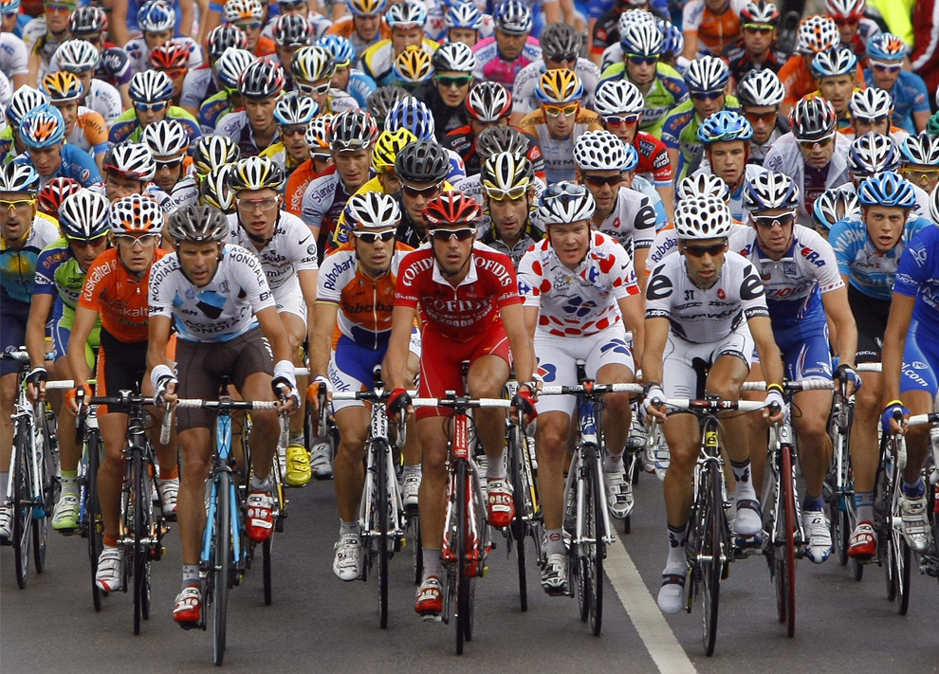
SOCIAL FACILITATION AND SPORTS
Triplett, a cyclist, observed that cyclists performed better when in a race as opposed to when they were riding against only themselves. (Triplet 1898)
He conducted a controlled lab experiment to see if the effect he saw in cycling had more general implications
He put children either in groups or alone and asked them to perform simple tasks. The children that were in a group performed more quickly, eg: in reeling a fishing rod, spun the reel much more quickly in groups than alone
Norman Triplett and the Bicycle Study
Norman Triplett (1861-1931)
In timed trials for track and field events, those racing others generally push themselves more than those who run alone
Workplace: adults work harder when they are competing against each other or in a group than when they are alone in a cubicle
social facilitation-can be seen beyond those lab experiments and cycling
There are limits to the social facilitation. If the task is too difficult, or the participants are easily stressed and intimidated, competition will only lessen the effectiveness of those people

Slide 10
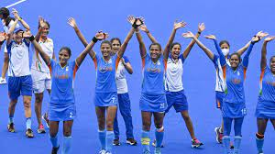
The focus of Sports Psychology is primarily on TEAM PERFORMANCE
Where does WELL BEING come in?

Slide 11

Sport psychology issues
Sport psychology methods
Issues pertaining to:
Motivation
focus/concentration
Thought patterns
arousal control,
Confidence and mental preparation
Psychological skills training
goal setting
Relaxation
Imagery
Self-talk
Thoughts
Mood
Well-Being

Slide 12
Course content
SPORTS AND WELL BEING
INTRODUCTION
WELL-BEING AND SPORTS – A study of interdependence
PHYSIOLOGICAL PARAMETERS OF WELL-BEING
Cardiovascular system in sports and exercise
Role of cardiovascular system in anxiety
Role of Neurotransmitters in well-being
Neurotransmitters and sports
Biomechanics in sports and fitness
INDIVIDUAL DIFFERENCES IN WELL BEING: Personality, Motivation and Cognition
Goal setting
Focus – Attention and concentration
Self-confidence and boosting
Role of sports in self-grooming
SPORTS AND PSYCHOLOGICAL SKILLS:
Introduction to mental skills training – Flow
Arousal regulation and coping
Mindfulness and relaxation
Visualisation and mental imagery
SPORTS SOCIAL SKILLS AND WELL BEING:
Aggression and mood
Communication skills
Role of Sports in building social skills
A HEALTHY DOSE OF SPORTS AND WELL BEING
Energy management
burnout
Sports as a paired career option

